Slide 1
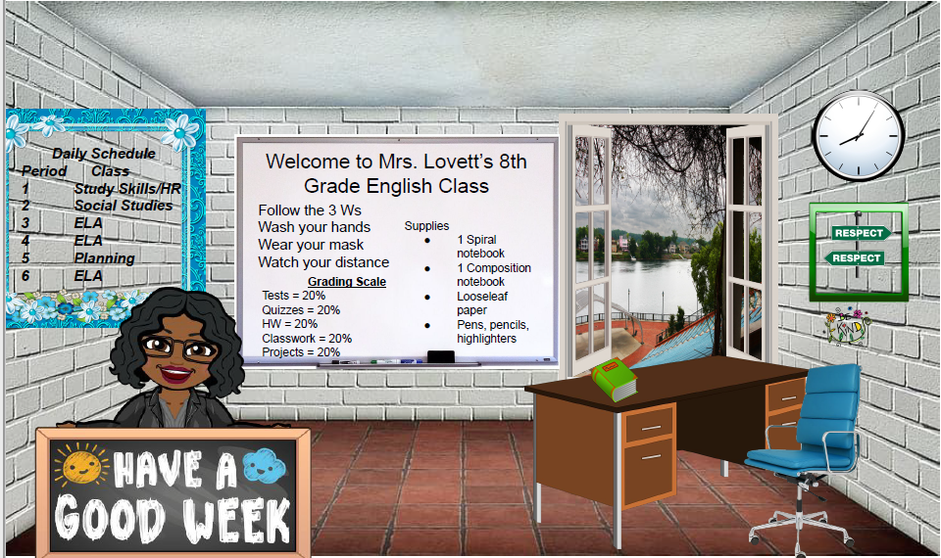

Contact Information: lovetca@Richmond.k12.ga.us
706 -592-3987
All about me!https://rcboe.instructure.com/profile

